Slide 1

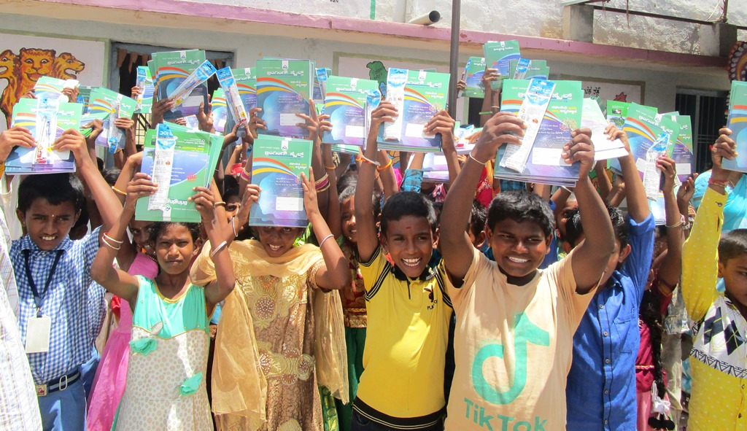

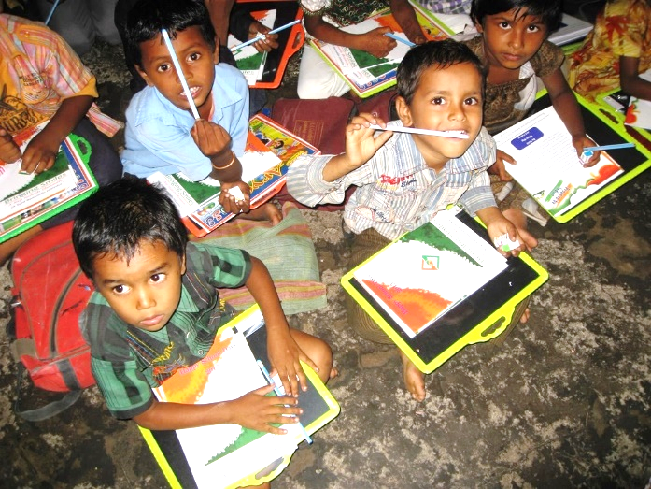
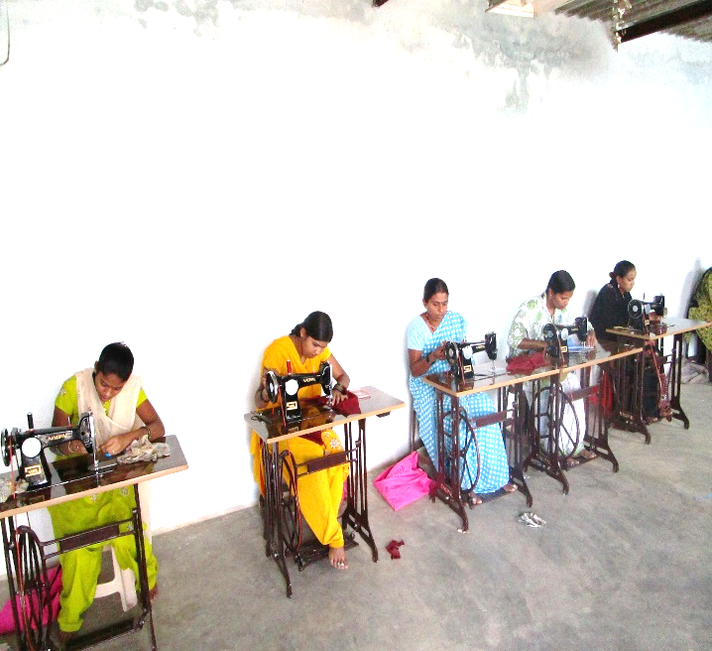



HOW CAN YOU MAKE A DIFFERENCE?
Charity begins at home my friend,
as does the community.
If you really want to make the world a better place, start by being polite to human being. With these thought, we are inviting students, working people, IT professionals with zeal to serve communities. Join us to help needy people in and around us.
“Being RICH is not about how much you have, but how much you can GIVE ! ”
Syed Nooruddin
Founder
How you can contribute 
Sponsor a child.
Become a Volunteer / coordinator in your locality / apartment / company.
Become a mentor for a child.
Contribute financially.
www.bsf.ngo
Bringing Smiles Foundation®
+91 906 611 2524
ngobsf@gmail.com

Slide 2

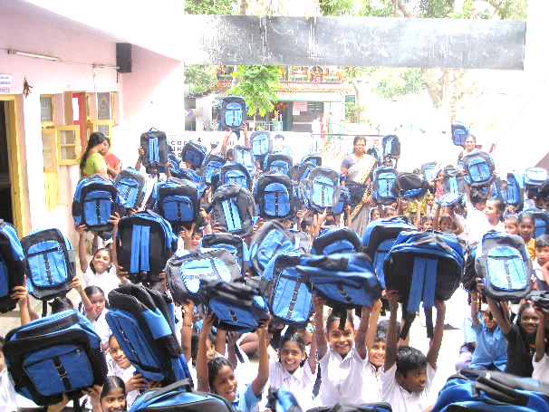
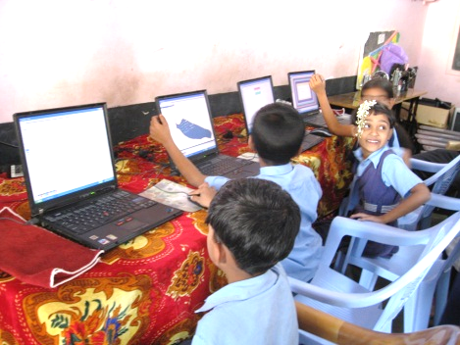
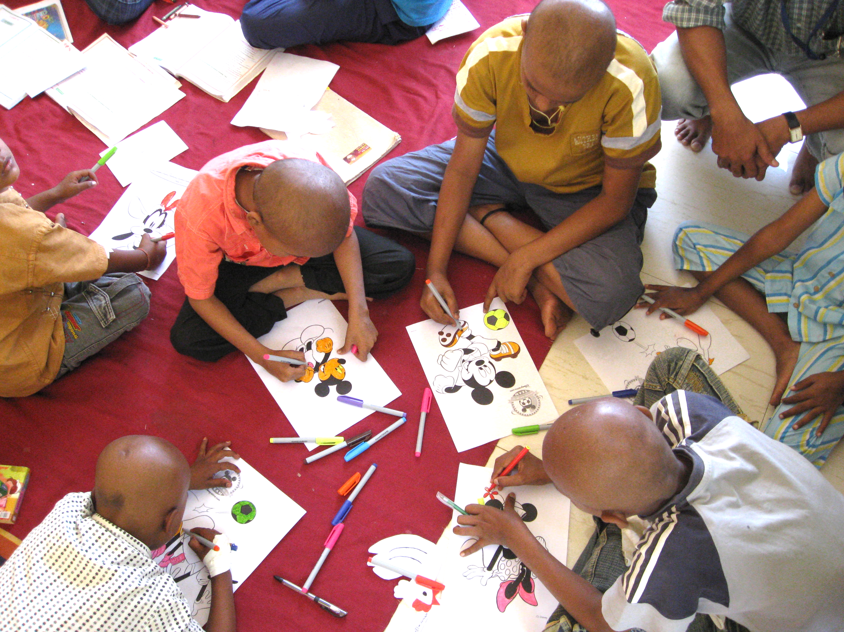
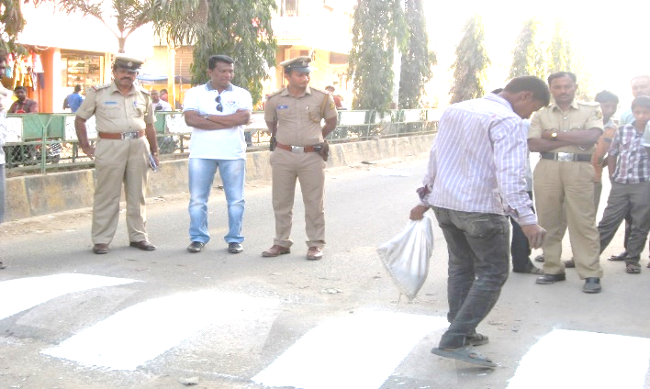

About Us
School Kit Distribution
Our Programs
“Bringing Smiles India Foundation ®” – A Step towards Humanity – is a non-profit organization, with an objective “To make a difference in the community around us, for those who are in need of basic necessities in the area of children education, women empowerment, provide help to needy and physically challenged people”.
“Bringing Smiles India Foundation ®” – A Step towards Humanity – is a registered NGO under Government of Karnataka, meets the needs of students in Government Schools, conducts Job skill-based programs for youth, women and people with disabilities and other specialized needs. Since 2009, Bringing Smiles donated School Kits to more than 44,150 students, setup 15 “Free Computer Labs”, conducted Self-employment training for Women and gets the supporting services they needed to be successful — such as soft skills training, additional education, or access to transportation and childcare.
01. Encourage Education in Rural Areas (EERA)
Free School Kit Distribution.
Free Computer Labs and education in Govt. Schools.
Pratibha Puraskara - to honor meritorious students.
02. Women In Self-Employment (WISE) Program
With an objective to create a tons of opportunity for many financially weak Women to learn job skills to make them self-dependent and start their own business and also make them Self-Employer with the help of latest infrastructure and technology.
03. Society Awareness Volunteering Events (SAVE)
“Bringing Smiles Foundation ®” – A Step towards Humanity Organizes and Conducts Society Awareness Volunteering Events to make “Clean, Beautiful and Safe Society”. Our programs include Road Humps painting, Traffic rule awareness, Health Camps and Hygienic life Awareness and many more.
Free Computer Labs in Govt. Schools
Fun & Learning @ Cancer Hospital
Zebra Crossing & Humps Painting event
Benefited
3500 Women
Reached
44150 kids

